Slide 1

Optimizing Global Safety Reporting in Clinical Trials Using Local Laws
Steven Beales
SVP, Scientific and Regulatory
WCG Clinical
@stevenbeales

Slide 2
Disclaimer – Content Slide
The views and opinions expressed in the following PowerPoint slides are those of the individual presenter and should not be attributed to Drug Information Association, Inc. (“DIA”), its directors, officers, employees, volunteers, members, chapters, councils, Communities or affiliates, or any organization with which the presenter is employed or affiliated.
These PowerPoint slides are the intellectual property of the individual presenter and are protected under the copyright laws of the United States of America and other countries. Used by permission. All rights reserved. Drug Information Association, Drug Information Association Inc., DIA and DIA logo are registered trademarks. All other trademarks are the property of their respective owners.

Slide 3






Problem with Global Safety Reporting
No Standards
Unclear Regulations
Conflicting Interpretations
Notes:
Are there any standards for distributing safety reports globally to investigators, ethics committees, and regulatory authorities? - No global standards.
Does each country uniquely regulate when and how interested parties receive safety reports? - Yes, over 40 different approaches.
Do biopharmas interpret local country rules themselves to decide what safety information should be distributed in a given country? - Yes, Biopharmas define what safety reports they will generate and how they will aggregate that information.
So 10 years later I’m still working on this problem. But we’ve made progress.

Slide 4


Problem with Lack of Global Harmonization
Regulatory Repercussions
Fractured Accountability
Increased Costs
Notes:
As clinical research becomes more global, this lack of global harmonization has become the No.1 safety reporting problem for Sponsors.
Because rules and practices vary from country to country, Sponsors live in fear of regulatory repercussions and changing regulations, which is the No.2 Safety Reporting problem.
It is difficult to understand in each country the role the Sponsor plays in coordination with the regulatory authority, the investigators, the ethics committees or DSMBs in sharing patient safety responsibilities.

Slide 5



Problem with Increasing Clinical Trial Complexity
Multiple Countries
Multiple Partners
Combination Studies
Notes:
Large clinical trials are magnifying the underlying problems we always faced in managing global teams and partners across multiple countries and affiliates.
27% of clinical trials are oncology-focused which generate 3-5x more severe ADRs than other therapeutic areas.
We’ve seen a 571% increase in SUSAR volume over 2 years at a Japanese Pharma who moved their portfolio towards oncology.

Slide 6

Problem of Clinical Trial Site Burden
Too Many Reports
Duplicate Reports
Overly Time-consuming
Too Many Websites
Useful Information Hidden
Notes:
Many companies still distribute all safety reports to all Sites and Ethics Committees due to a literal interpretation of GCP instead of observing local laws.
Sites are overwhelmed with over-reported and cross-reported safety reports due to this “brute-force” distribution.
80% of sites receive more than 20 SUSARs per month and take an average of 2 hours per SUSAR to process.
20% have refused to process a SUSAR because it was an over-distribution. We get at least 1 call every month from a site in US that asks “Why can’t sponsors get their act together and stop sending us SUSARs where there is no causal relationship to the drug?”
This is our current reality that will be all too familiar to most of you. But it doesn’t have to be that way.

Slide 7

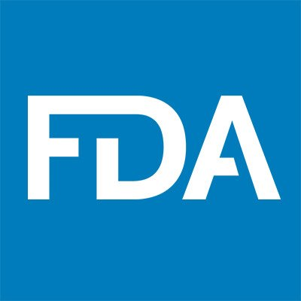



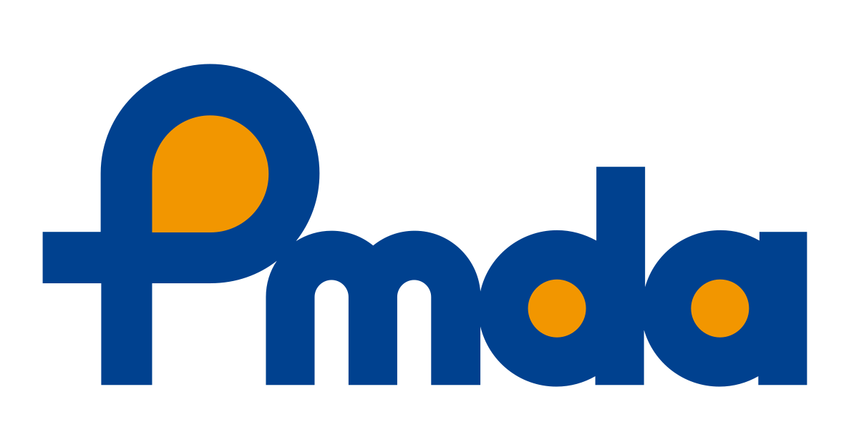
Safety Reporting Harmonization Working Group
Top 1 US Pharma
Top 1 EU Pharma
Top 1 US IRB
Top 1 US CRO
Top 2 Japan Pharma
Top 3 US Biotech
Notes:
Earlier this year, I was privileged to be asked to co-chair the Safety Reporting Harmonization Working Group with experts from many of the leading companies in our industry.
Our mission is to -
Drive global harmonization in reporting rules for Investigators and Ethics Committees by creating a reference model of global safety reporting rules
Develop models for “niche” countries where regulations are unknown so as not to delay site or study activation
Understand the end to end process flows of Safety Reporting between Patients, Investigators, Sponsor, CRO, Regulatory Authority, and Ethics Committees

Slide 8



Safety Reporting Reference Model
125 Countries
7800 Country Rules
Quarterly Updates
Notes:
We are pleased to release our first working group deliverable at this DIA 2019 conference - the safety reporting reference model version 1.0 for 125 countries and 63 different types of local rules.
The model contains over 7800 country rules and I’d like to thank the companies who donated and harmonized their interpretations over the last few months. This has enabled us to reduce every rule to a picklist of 3-5 options.
We will be publishing updates to this model every 3 months.

Slide 9
Model Example – Expedited Reporting
Country Breakdown of Expedited Reporting
Notes:
As an example of the patterns we’ve found in our analysis, there are 5 different types of expedited reporting that occur in countries either
All SUSARs, No SUSARs, Domestic Only, Protocol Specific and Both Protocol Specific and Domestic Only.
36% of countries have some form of reduced expedited reporting.
If a sponsor sends SUSARs to all Sites and Ethics Committees, they are over-distributing by about 50% according to local laws.
Removing this over-distribution translates into savings of 10s of millions at the largest biopharmas.
Mid-size biopharmas are likely to see savings over $5m per year when site and monitoring costs are factored in.

Slide 10

Precision Safety Reporting
Right Information
Right Time
Right Person
Notes:
When building the reference model our vision was a system that would send the right safety report to the right person at the right time anywhere in the world according to local law.
We catalogued all the variations in local laws that affect safety reporting and stored them in a rules database that could be used to power a safety reporting system.

Slide 11


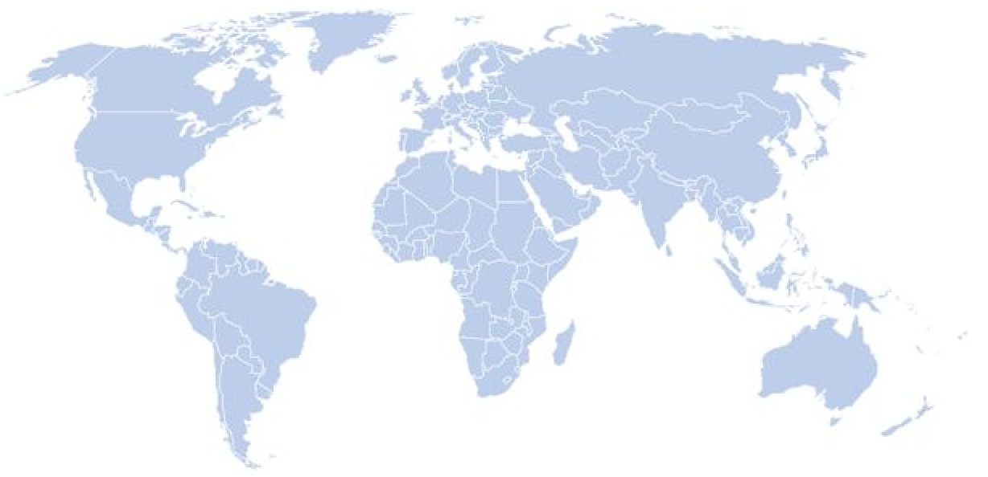
Safety Portal Artificial Intelligence
Precision Distribution
50m Safety Notifications
75k Safety Reports
Safety Reference Model
Notes:
4 of our 6 working group members have launched rules-based Artificial Intelligences that use the safety reference model to power precision distribution to sites, ECs and RAs in over 100 countries.
The AI considers causality, unblinding, RSI, cross reporting, country, site and EC rules to make its reporting decisions.
By end of 2019, these systems will have sent over 75k SUSARs and over 50m safety letters.

Slide 12


Model Outcomes - Increased Transparency
Quality Oversight
Study and
Compound
Compliance
Notes:
Some outcomes we are already seeing at our founding biopharmas
Absence of compliance findings –
The model prevents non-compliant activities such as distributing unapproved versions of RSI to investigators within IBs
The model ensures that a biopharma has traceability for unblinded distribution to local ECs.

Slide 13



Model Outcomes – Group Standards
Standard Process
Multiple System Integrations
Clear Country Rules
Notes:
Safety Reporting Reference Model provides a standard process for sponsors to follow to distribute safety reports while eliminating the underlying complex domain knowledge by delegating that to software.
Clear country rules remove the fear of non-compliance that drives over-distribution.

Slide 14

Reduction in Clinical Trial Costs
Costs Avoided
$7,500 per Safety Report
Notes:
By using local laws, the mean reduction in number of Safety Letters per Safety Report has been 51%.
Assuming site and CRO costs of $50 per Safety Letter, this has resulted in approximately a $7500 saving per Safety Report.
For the average phase 2 clinical trial, savings have ranged between $150k and $450k per trial.

Slide 15
Reduction in Site Burden
Reduction in Site Burden
10 hours per week
Notes:
Average reduction in Safety Reports per Site has been 5 safety letters per week.
On average 2 hours per Safety Report is used by a site to read, process and file a safety letter in Investigator Site File so that is 10 hours per week.
Mean savings for the sponsor at each site is $1k per month.

Slide 16
Benefits of Right-Sizing Safety Reporting
Improve Patient Safety
Make Sites Happier
Pass Inspections
Avoid Costs
Notes:
By eliminating over-distribution of safety reports, a sponsor may transform their clinical operations –
improve patient safety
reduce site burden
improve compliance
save money.

Slide 17

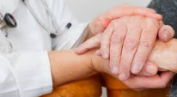
1 in 3 Hospital Admissions Over 65
Every 30 seconds
Notes:
Why is it so important for us to fix global safety reporting problems now?
In the last 20 minutes, 40 people were admitted to hospital in US suffering from a serious adverse drug reaction.
For the elderly, ADEs make up 1/3rd of hospital admissions.
The risk of an ADE is over 50% for those on 5 meds or more.
Meanwhile, post-market safety surveillance has remained constant at 0.03% of Pharma Sales.

Slide 18

Notes:
Please join with us and help us to build the safety reporting reference model.
May all our future global safety reporting be precise and according to local law.

Slide 19

Thank You
Steven Beales
SVP, Scientific and Regulatory
WCG Clinical
@stevenbeales
sbeales@wcgclinical.com
Join the conversation #DIA2019

